Slide 1
Assessing Model Fit II

Slide 2
Announcements
SPH Student Survey:
https://ohsu.ca1.qualtrics.com/jfe/form/SV_0OH1eqNZtawhhcy
Quarto workshop
https://sites.google.com/view/asa-oregon-chapter-short-cours
Fee waived for first 25 students who sign up!
Attending half, and leaving after the lunch break could work?
Will post Midterm feedback form by end of this week
Should take about 10 minutes

Slide 3
Class 15 Learning Objectives
Revisit Pearson Residual: How to extract Pearson residuals and other summary measures in R
Apply AIC and BIC as a summary measure to make additional comparisons between potential models
Understand the components of calculations for logistic regression diagnostics
Plot and determine observations where regression does not fit well or are influential using specific diagnostic values

Slide 4
Class 15 Learning Objectives
Revisit Pearson Residual: How to extract Pearson residuals and other summary measures in R
Apply AIC and BIC as a summary measure to make additional comparisons between potential models
Understand the components of calculations for logistic regression diagnostics
Plot and determine observations where regression does not fit well or are influential using specific diagnostic values

Slide 5
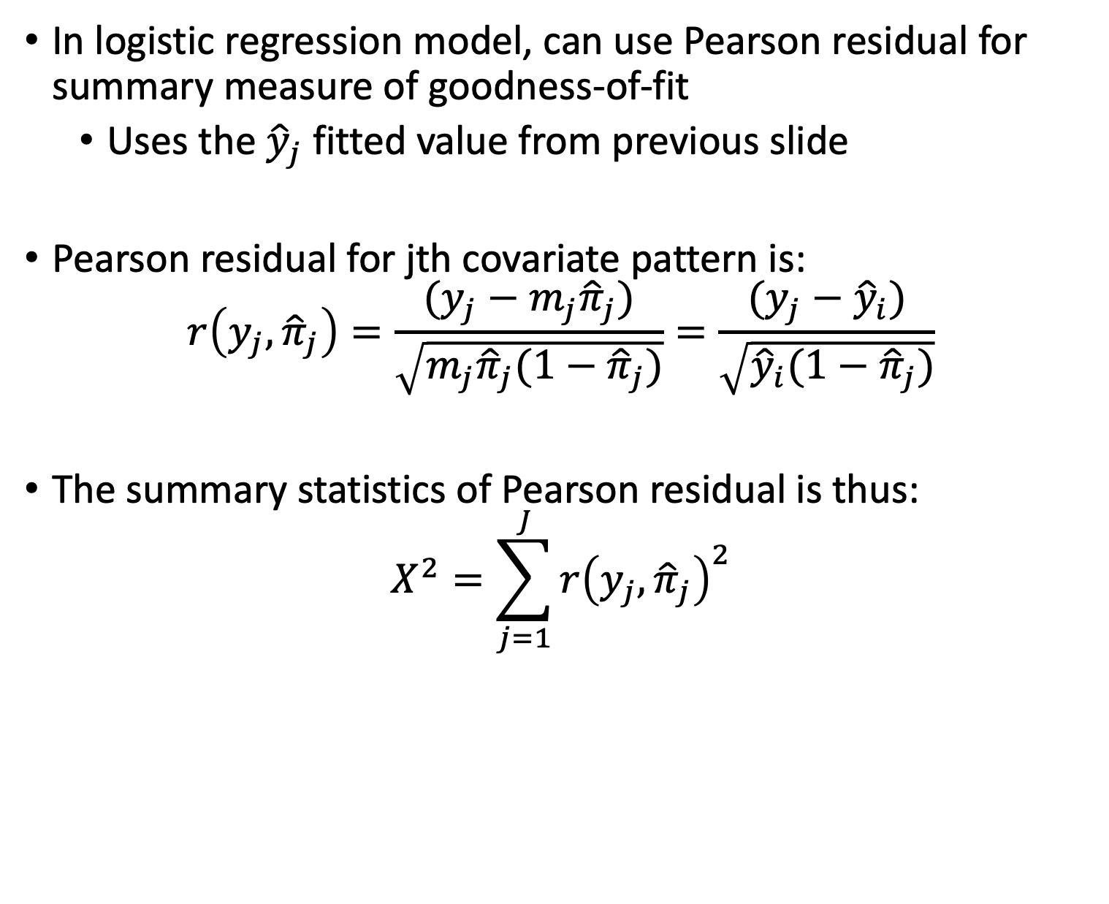
Pearson Residual (I)
In logistic regression model, can use Pearson residual for summary measure of goodness-of-fit
Uses the ${\hat{y}}_{j}$ fitted value from previous slide
Pearson residual for jth covariate pattern is:
$$r\left(y_{j},{\hat{π}}_{j}\right)=\frac{(y_{j}−m_{j}{\hat{π}}_{j})}{\sqrt{m_{j}{\hat{π}}_{j}(1−{\hat{π}}_{j})}}=\frac{(y_{j}−{\hat{y}}_{i})}{\sqrt{{\hat{y}}_{i}(1−{\hat{π}}_{j})}}$$
The summary statistics of Pearson residual is thus:
$$X^{2}=\sum_{j=1}^{J}{r{\left(y_{j},{\hat{π}}_{j}\right)}^{2}}$$

Slide 6
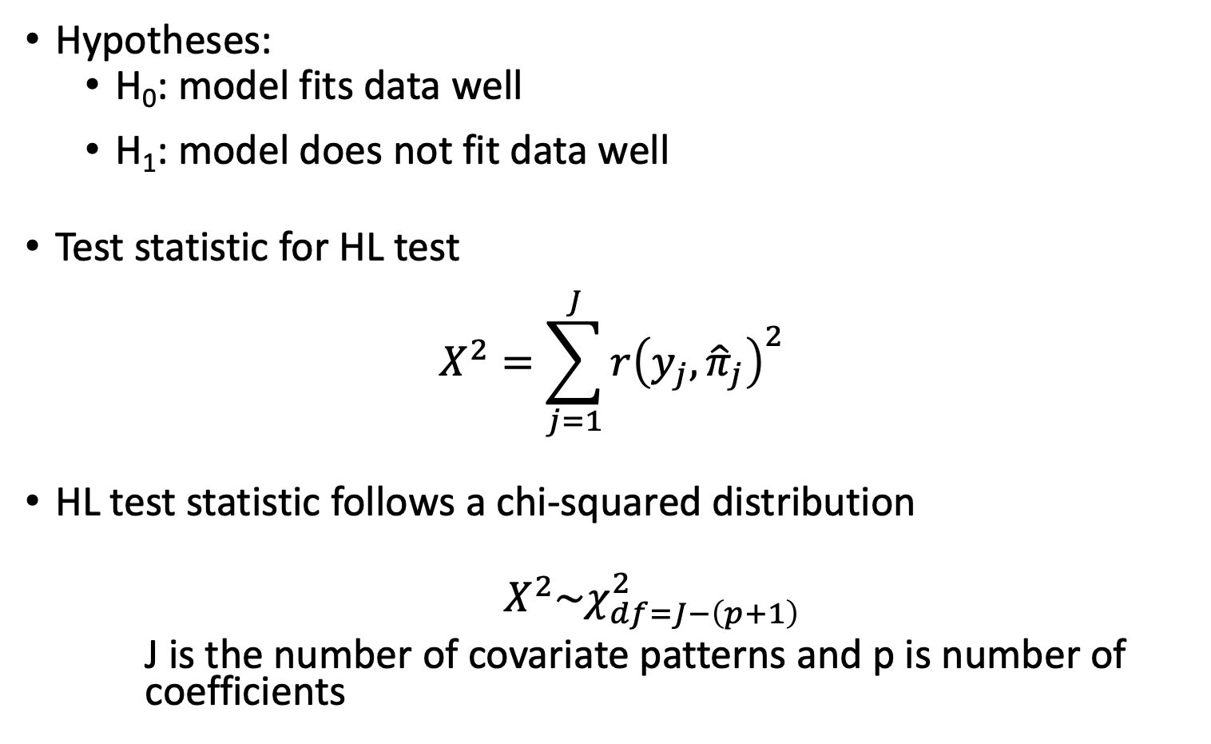
Pearson residual: key info for testing
Hypotheses:
H₀: model fits data well
H₁: model does not fit data well
Test statistic for HL test
$$X^{2}=\sum_{j=1}^{J}{r{\left(y_{j},{\hat{π}}_{j}\right)}^{2}}$$
HL test statistic follows a chi-squared distribution
$Χ^{2}\sim χ_{df=J−\left(p+1\right)}^{2}$
J is the number of covariate patterns and p is number of coefficients

Slide 7
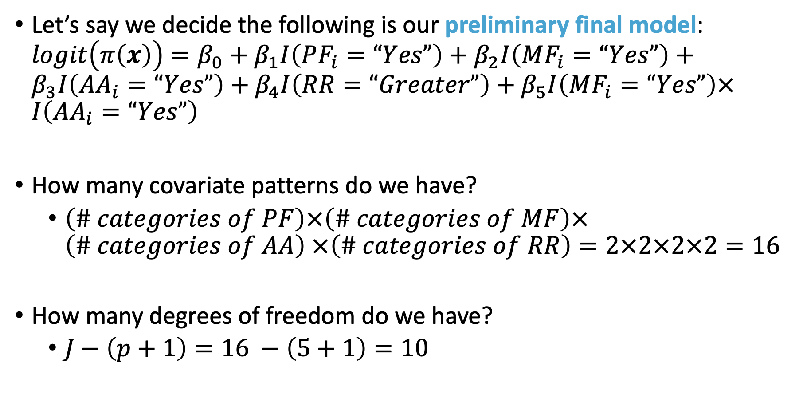
Pearson Residuals: GLOW Study
Let’s say we decide the following is our preliminary final model: $logit\left(π\left(x\right)\right)=β_{0}+β_{1}I\left(PF_{i}=“Yes”\right)+β_{2}I\left(MF_{i}=“Yes”\right)+β_{3}I\left(AA_{i}=“Yes”\right)+β_{4}I\left(RR=“Greater”\right)+β_{5}I\left(MF_{i}=“Yes”\right)×I\left(AA_{i}=“Yes”\right)$
How many covariate patterns do we have?
$\left(\# categories of PF\right)×\left(\# categories of MF\right)×\left(\# categories of AA\right)$ $×\left(\# categories of RR\right)=2×2×2×2=16$
How many degrees of freedom do we have?
$J−\left(p+1\right)=16 −\left(5+1\right)=10$

Slide 8
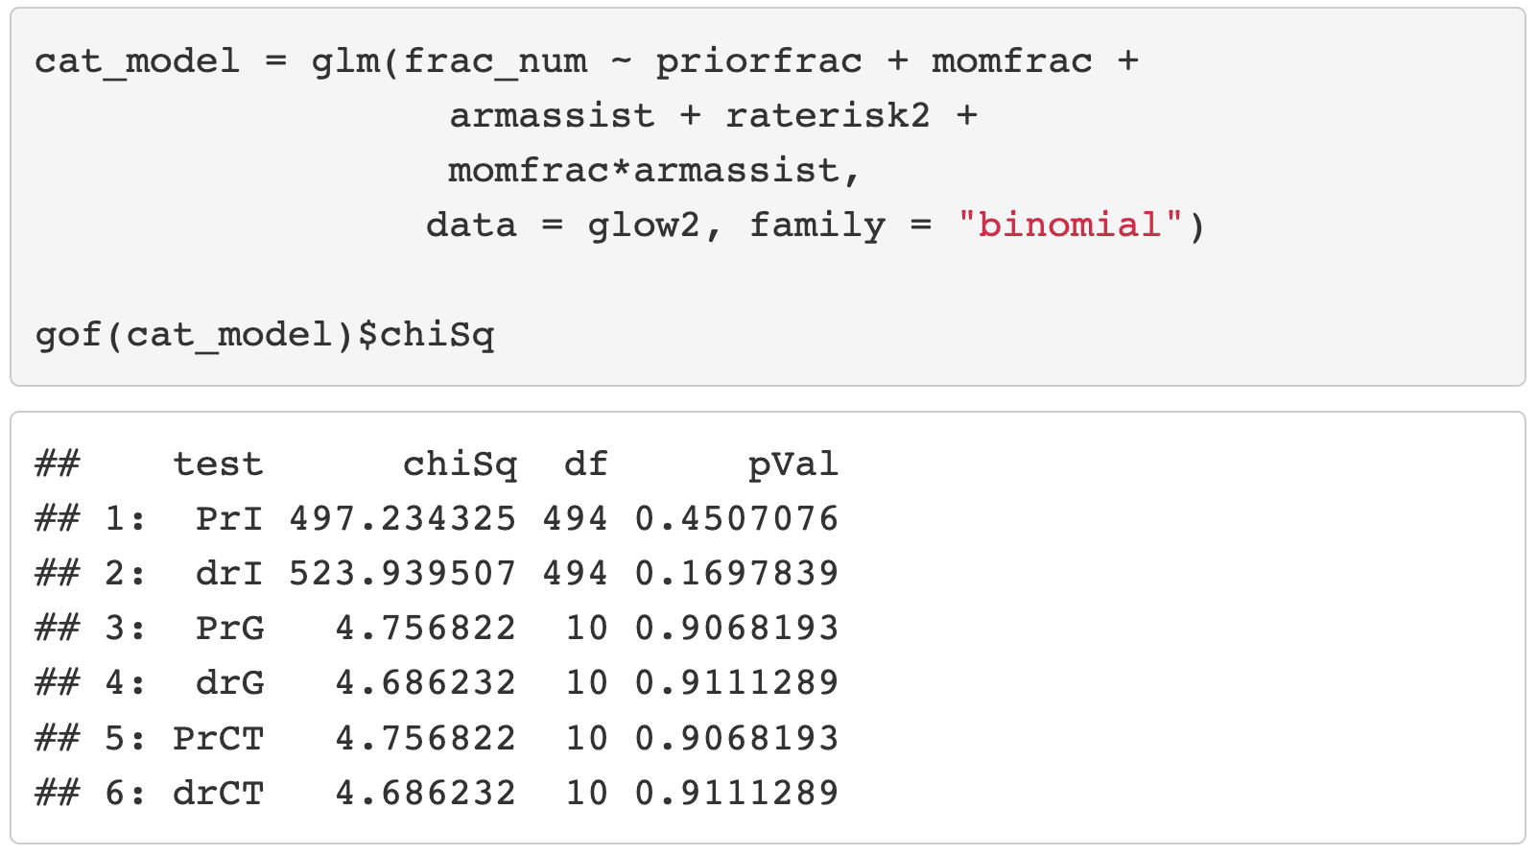
Pearson Residuals: GLOW Study
Fit the preliminary final model

Slide 9
Class 15 Learning Objectives
Revisit Pearson Residual: How to extract Pearson residuals and other summary measures in R
Apply AIC and BIC as a summary measure to make additional comparisons between potential models
Understand the components of calculations for logistic regression diagnostics
Plot and determine observations where regression does not fit well or are influential using specific diagnostic values

Slide 10
AIC and BIC (I)
Two widely used non-hypothesis testing based measurements that helps select a good model
Akaike Information Criterion (AIC)
Bayesian Information Criterion (BIC)
Unlike likelihood ratio test which is only suitable for nested model, AIC and BIC are suitable for both nested and non-nested model
There is no hypothesis/conclusion testing for the comparison between two models
So not the best for selecting covariates to include in model
BUT helpful if you have a few preliminary final models that you want to compare

Slide 11
Poll Everywhere Question 1

Slide 12
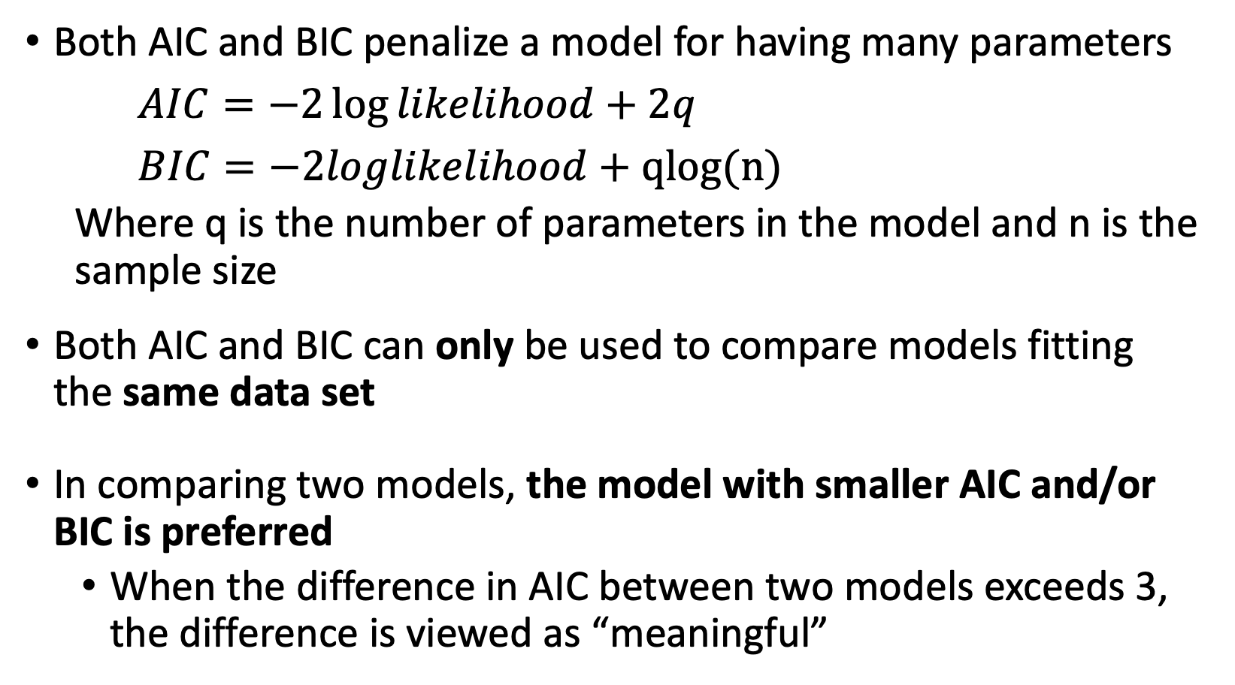
AIC and BIC (II)
Both AIC and BIC penalize a model for having many parameters
$AIC=−2\log{likelihood}+2q$
$BIC=−2loglikelihood+qlog(n)$
Where q is the number of parameters in the model and n is the sample size
Both AIC and BIC can only be used to compare models fitting the same data set
In comparing two models, the model with smaller AIC and/or BIC is preferred
When the difference in AIC between two models exceeds 3, the difference is viewed as “meaningful”

Slide 13
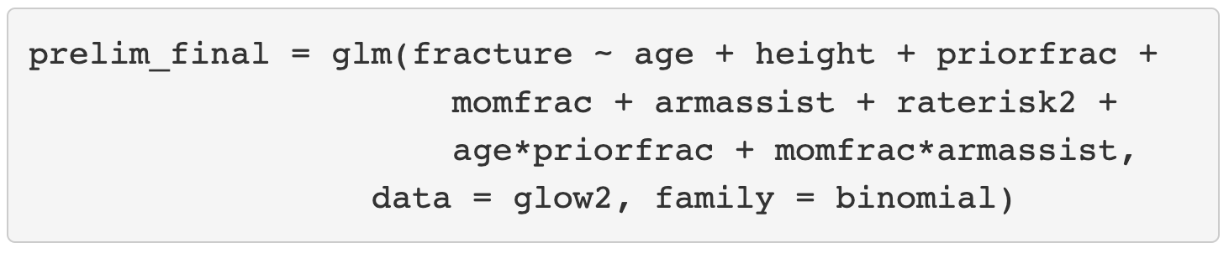
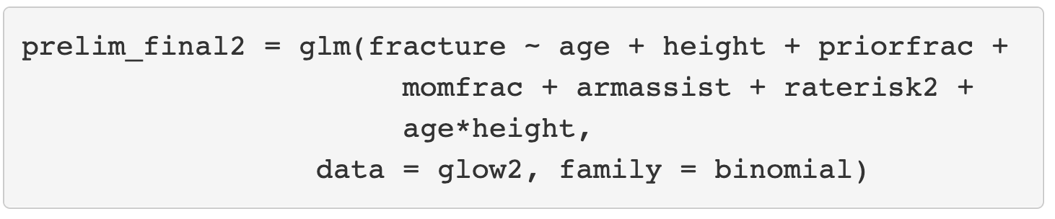
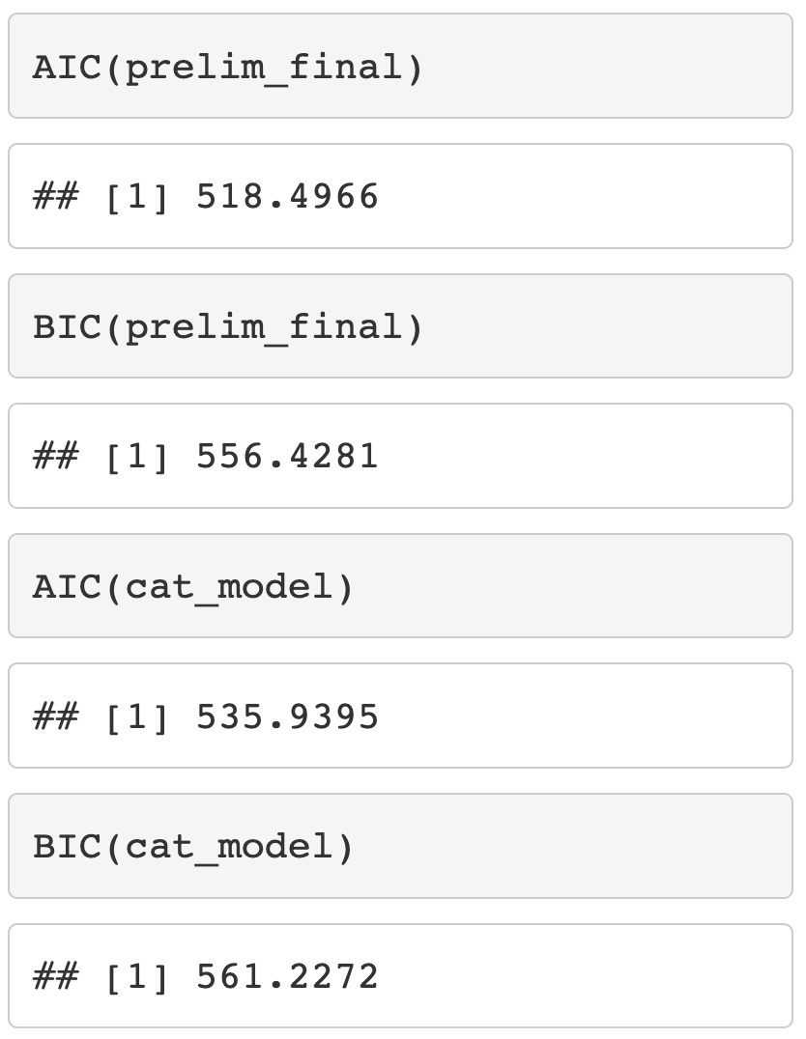
AIC and BIC in R and SAS
After fitting the logistic regression model, can calculate AIC and BIC

Slide 14
Components to Assess Model Fit (I)
Computation and evaluation of overall measures of fit
Examination of the individual components of the summary statistics (often through picture)
Examination of other measures of the difference or distance between the observed and fitted values

Slide 15
Components to Assess Model Fit (I)
LAST CLASS
Computation and evaluation of overall measures of fit
Examination of the individual components of the summary statistics (often through picture)
Examination of other measures of the difference or distance between the observed and fitted values

Slide 16
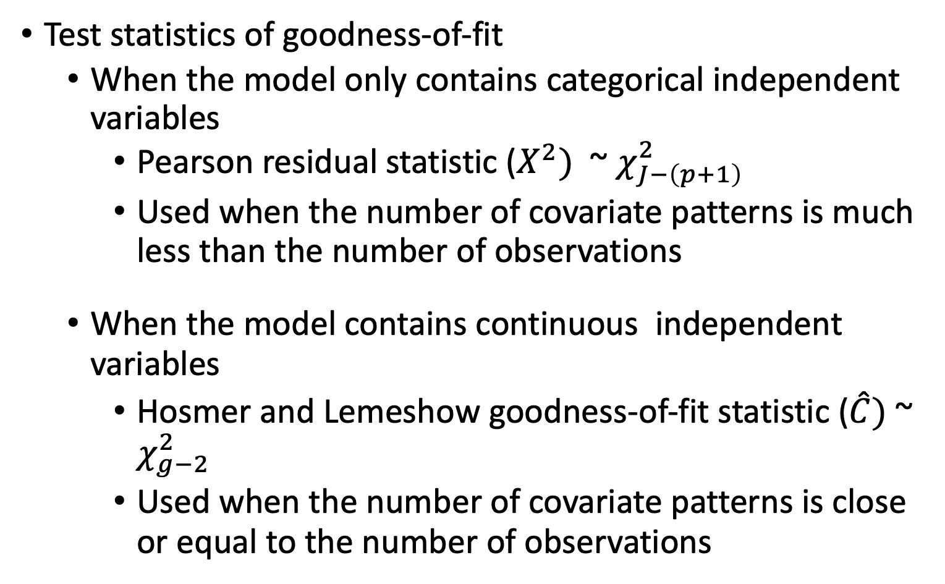
Review of Overall Measure of Fit (I)
Test statistics of goodness-of-fit
When the model only contains categorical independent variables
Pearson residual statistic ($X^{2})$ ~ $χ_{J−\left(p+1\right)}^{2}$
Used when the number of covariate patterns is much less than the number of observations
When the model contains continuous independent variables
Hosmer and Lemeshow goodness-of-fit statistic ($\hat{C})$~ $χ_{g−2}^{2}$
Used when the number of covariate patterns is close or equal to the number of observations

Slide 17
Review of Overall Measure of Fit (II)
Area under ROC
Measure the ability of the multiple logistics regression to discriminate between those subjects who experience the outcome versus those who do not
AIC and BIC
Used to compare non-nested (and nested) models.

Slide 18
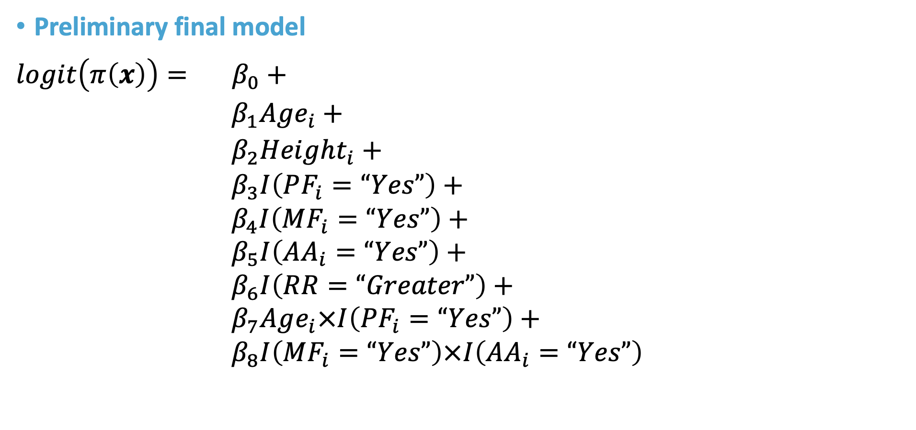
Review of Overall Measure of Fit: GLOW Study
PF = Prior Fracture
MF = Mom had fracture
AA = Arm Assistance
Preliminary final model
$$logit\left(π\left(x\right)\right)= β_{0}+$$ $β_{1}Age_{i}+$ $β_{2}Height_{i}+$
$β_{3}I\left(PF_{i}=“Yes”\right)+$
$β_{4}I\left(MF_{i}=“Yes”\right)+$
$β_{5}I\left(AA_{i}=“Yes”\right)+$
$β_{6}I\left(RR=“Greater”\right)+$
$β_{7}Age_{i}×I\left(PF_{i}=“Yes”\right)+$
$β_{8}I\left(MF_{i}=“Yes”\right)×I\left(AA_{i}=“Yes”\right)$

Slide 19
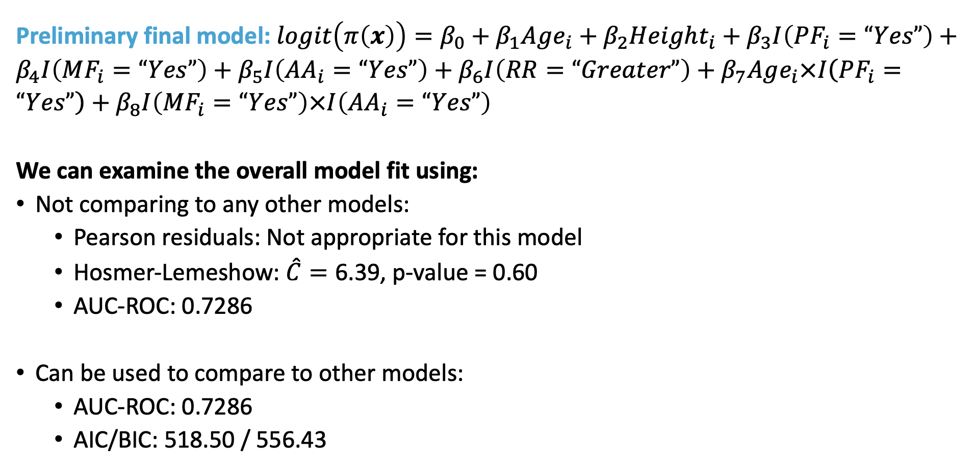
Review of Overall Measure of Fit: GLOW Study
Preliminary final model: $logit\left(π\left(x\right)\right)=β_{0}+β_{1}Age_{i}+β_{2}Height_{i}+β_{3}I\left(PF_{i}=“Yes”\right)+β_{4}I\left(MF_{i}=“Yes”\right)+β_{5}I\left(AA_{i}=“Yes”\right)+β_{6}I\left(RR=“Greater”\right)+β_{7}Age_{i}×I\left(PF_{i}=“Yes”\right)+β_{8}I\left(MF_{i}=“Yes”\right)×I\left(AA_{i}=“Yes”\right)$
We can examine the overall model fit using:
Not comparing to any other models:
Pearson residuals: Not appropriate for this model
Hosmer-Lemeshow: $\hat{C}=\text{6.39}$, p-value = 0.60
AUC-ROC: 0.7286
Can be used to compare to other models:
AUC-ROC: 0.7286
AIC/BIC: 518.50 / 556.43

Slide 20
Class 15 Learning Objectives
Revisit Pearson Residual: How to extract Pearson residuals and other summary measures in R
Apply AIC and BIC as a summary measure to make additional comparisons between potential models
Understand the components of calculations for logistic regression diagnostics
Plot and determine observations where regression does not fit well or are influential using specific diagnostic values

Slide 21
Review of Number of Covariate Patterns
Covariate patterns are the unique covariate combinations that are observed
For example: model contains two categorical covariates (sex assigned at birth and smoking status), there will be 4 unique combination of these factors
This model has 4 covariate patterns
When we have continuous covariates, the number of covariate patterns will be close to the number of individuals in the dataset

Slide 22
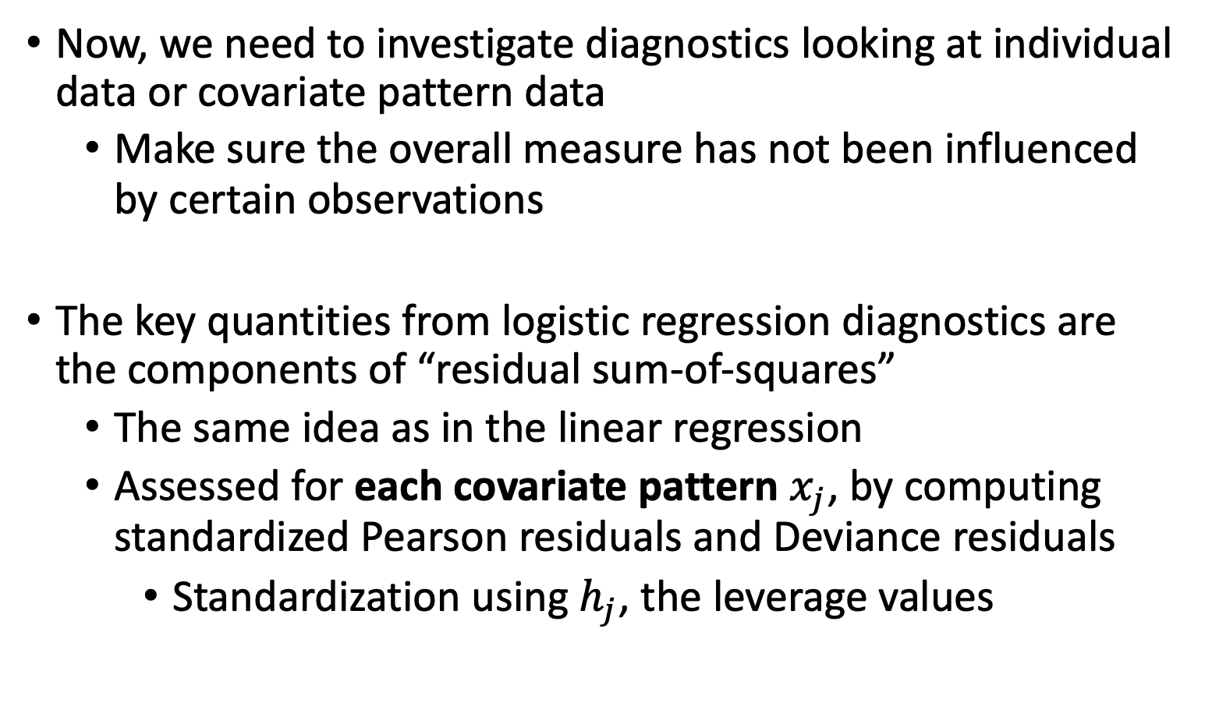
Overall measure to diagnostics
Now, we need to investigate diagnostics looking at individual data or covariate pattern data
Make sure the overall measure has not been influenced by certain observations
The key quantities from logistic regression diagnostics are the components of “residual sum-of-squares”
The same idea as in the linear regression
Assessed for each covariate pattern $x_{j}$, by computing standardized Pearson residuals and Deviance residuals
Standardization using $h_{j}$, the leverage values

Slide 23
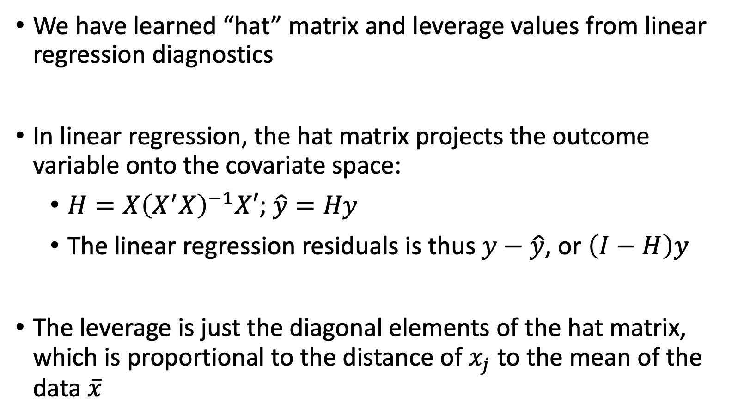
Hat Matrix and Leverage Values (I)
We have learned “hat” matrix and leverage values from linear regression diagnostics
In linear regression, the hat matrix projects the outcome variable onto the covariate space:
$H=X{\left(X^{′}X\right)}^{−1}X′$; $\hat{y}=Hy$
The linear regression residuals is thus $y−\hat{y}$, or $\left(I−H\right)y$
The leverage is just the diagonal elements of the hat matrix, which is proportional to the distance of $x_{j}$ to the mean of the data $\overline{x}$

Slide 24
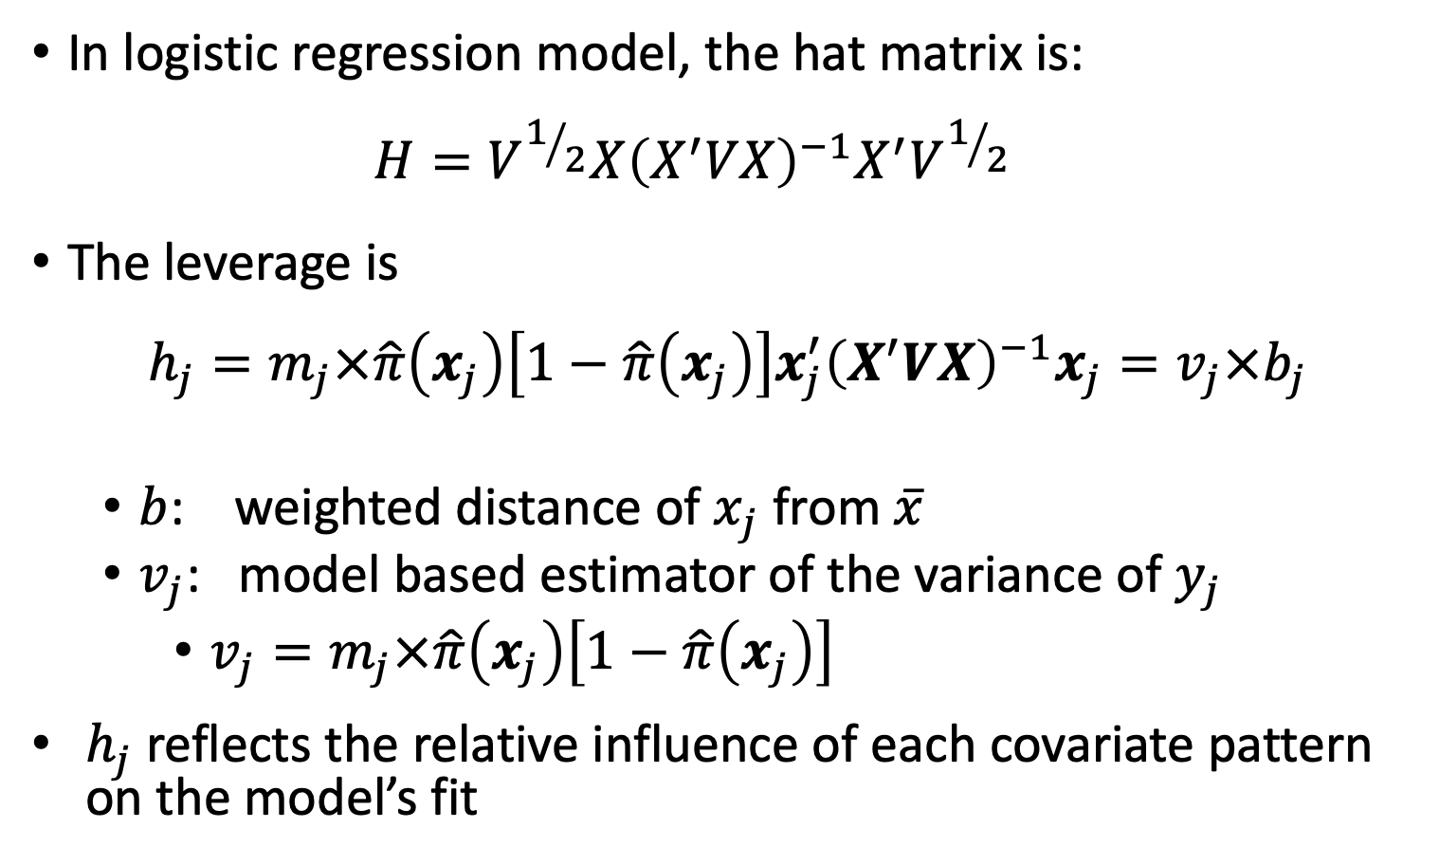
Hat Matrix and Leverage Values (II)
In logistic regression model, the hat matrix is:
$$H=V^{1/2}X{\left(X^{′}VX\right)}^{−1}X^{′}V^{1/2}$$
The leverage is
$$h_{j}=m_{j}×\hat{π}\left(x_{j}\right)\left[1−\hat{π}\left(x_{j}\right)\right]x_{j}^{′}{\left(X^{′}VX\right)}^{−1}x_{j}=v_{j}×b_{j}$$
$b$: weighted distance of $x_{j}$ from $\overline{x}$
$v_{j}$: model based estimator of the variance of $y_{j}$
$v_{j}=m_{j}×\hat{π}\left(x_{j}\right)\left[1−\hat{π}\left(x_{j}\right)\right]$
$h_{j}$ reflects the relative influence of each covariate pattern on the model’s fit

Slide 25
Diagnostic Statistics Computation (I)
Two diagnostic statistics computation approach
Approach 1: computed by covariate pattern
Recommendation of HLS textbook.
R uses this approach
Identify outliers as group that shares the same covariate values (in the same covariate pattern)
Approach 2: individual observation approach
SAS uses this approach
Identify outliers as individual

Slide 26
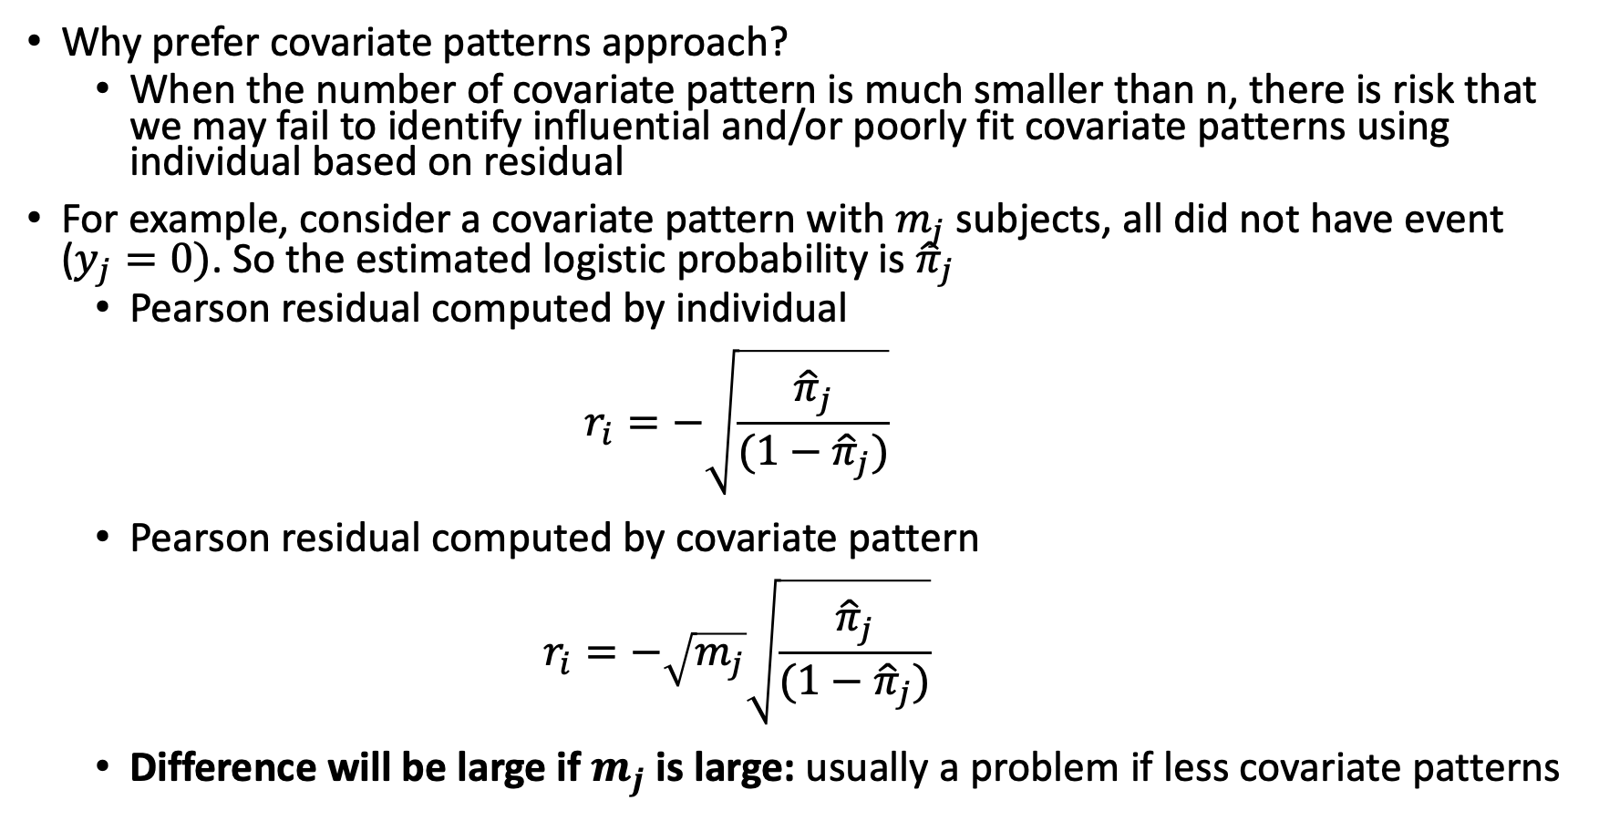
Diagnostic Statistics Computation (II)
Why prefer covariate patterns approach?
When the number of covariate pattern is much smaller than n, there is risk that we may fail to identify influential and/or poorly fit covariate patterns using individual based on residual
For example, consider a covariate pattern with $m_{j}$ subjects, all did not have event ($y_{j}=0)$. So the estimated logistic probability is ${\hat{π}}_{j}$
Pearson residual computed by individual
$$r_{i}=−\sqrt{\frac{{\hat{π}}_{j}}{(1−{\hat{π}}_{j})}}$$
Pearson residual computed by covariate pattern
$$r_{i}=−\sqrt{m_{j}}\sqrt{\frac{{\hat{π}}_{j}}{(1−{\hat{π}}_{j})}}$$
Difference will be large if $m_{j}$ is large: usually a problem if less covariate patterns

Slide 27
10 minute break?

Slide 28
Class 15 Learning Objectives
Revisit Pearson Residual: How to extract Pearson residuals and other summary measures in R
Apply AIC and BIC as a summary measure to make additional comparisons between potential models
Understand the components of calculations for logistic regression diagnostics
Plot and determine observations where regression does not fit well or are influential using specific diagnostic values

Slide 29
Diagnostics of Logistic Regression
Model diagnostics of logistic regression can be assessed by checking how influential a covariate pattern is:
Look at change in residuals if a covariate pattern is excluded
Standardized Pearson residual
Standardized Deviance residual
Look at change in coefficients if a covariate pattern is excluded

Slide 30
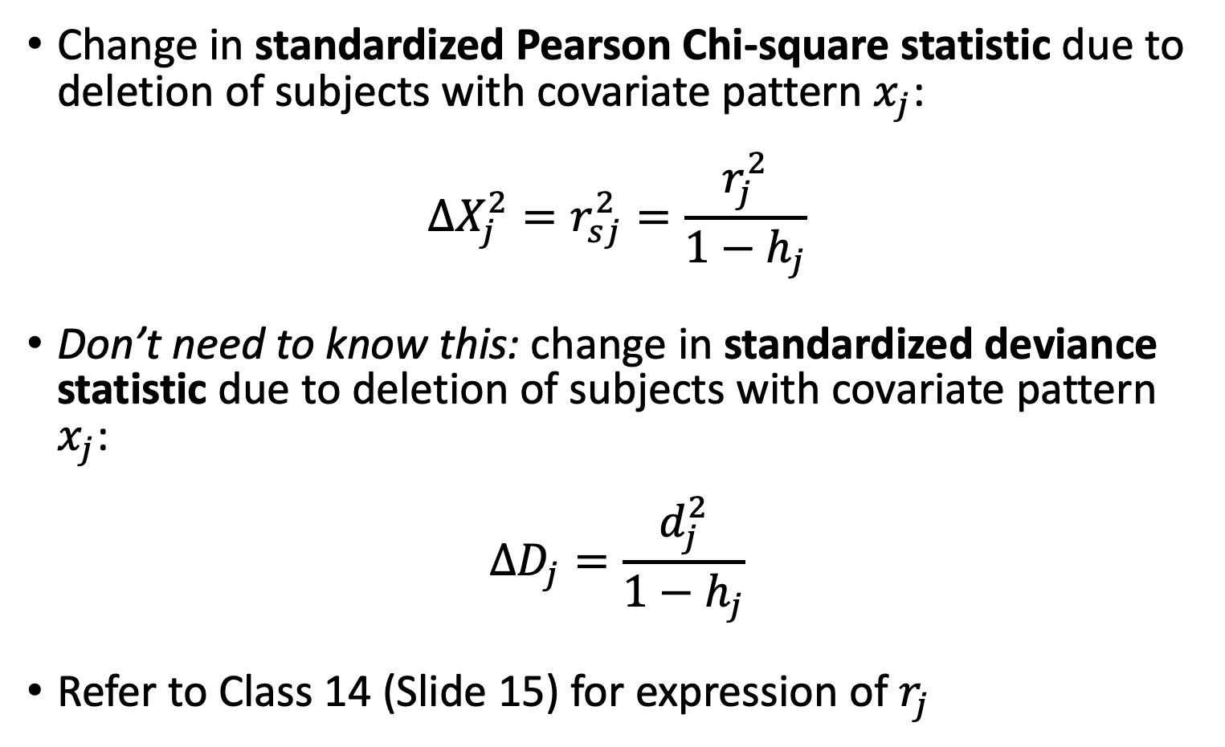
Change of Standardized Residuals
Change in standardized Pearson Chi-square statistic due to deletion of subjects with covariate pattern $x_{j}$:
$$∆X_{j}^{2}=r_{sj}^{2}=\frac{r_{j}^{2}}{1−h_{j}}$$
Don’t need to know this: change in standardized deviance statistic due to deletion of subjects with covariate pattern $x_{j}$:
$$∆D_{j}=\frac{d_{j}^{2}}{1−h_{j}}$$
Refer to Class 14 (Slide 15) for expression of $r_{j}$

Slide 31
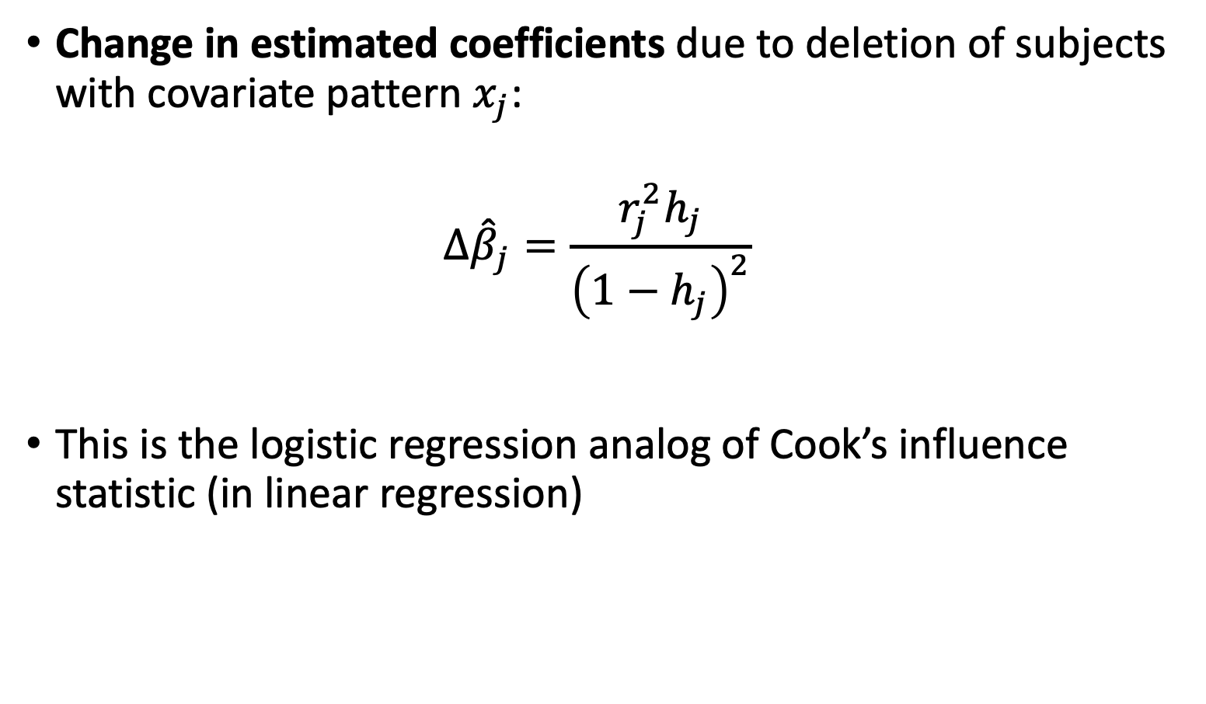
Change of Estimated Coefficients
Change in estimated coefficients due to deletion of subjects with covariate pattern $x_{j}$:
$$∆{\hat{β}}_{j}=\frac{r_{j}^{2}h_{j}}{{\left(1−h_{j}\right)}^{2}}$$
This is the logistic regression analog of Cook’s influence statistic (in linear regression)

Slide 32
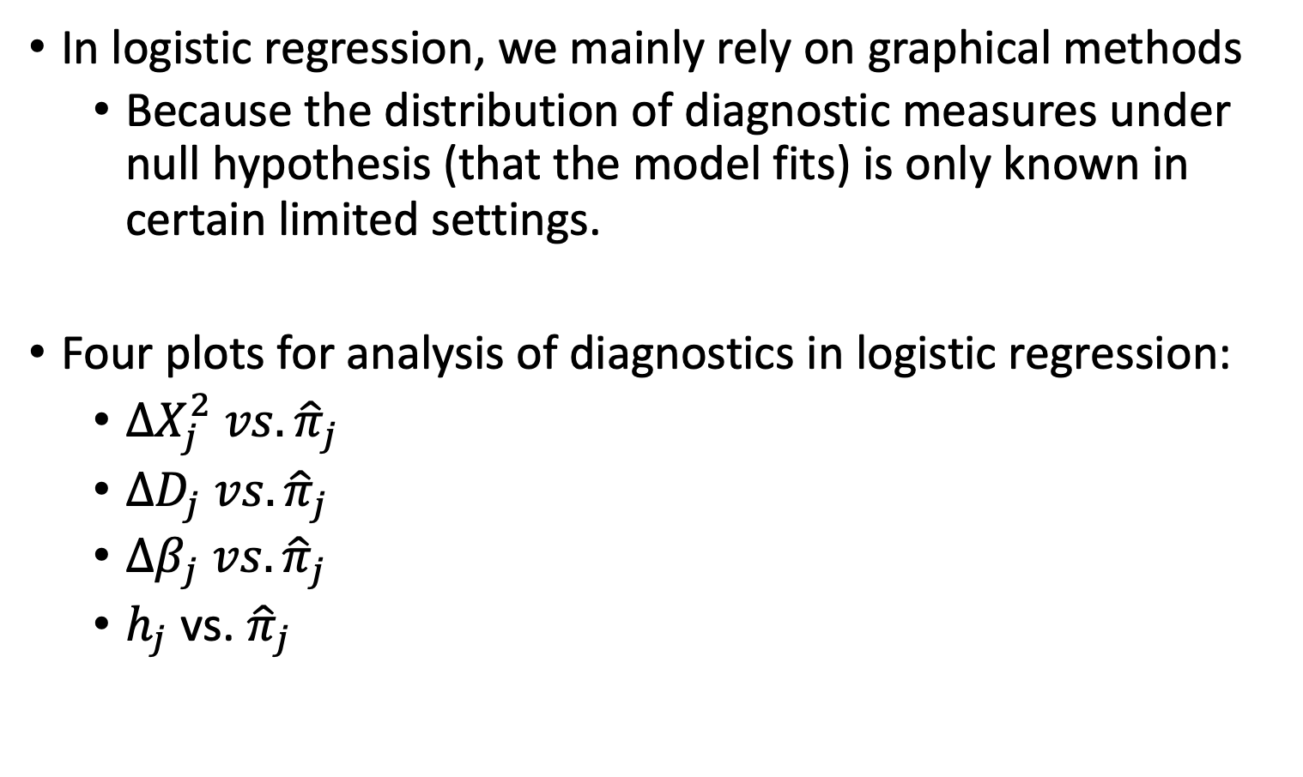
Visual Assessment for Diagnostics of Logistic Regression (I)
In logistic regression, we mainly rely on graphical methods
Because the distribution of diagnostic measures under null hypothesis (that the model fits) is only known in certain limited settings.
Four plots for analysis of diagnostics in logistic regression:
$∆X_{j}^{2} vs. {\hat{π}}_{j}$
$∆D_{j} vs. {\hat{π}}_{j}$
$∆β_{j} vs. {\hat{π}}_{j}$
$h_{j}$ vs. ${\hat{π}}_{j}$

Slide 33
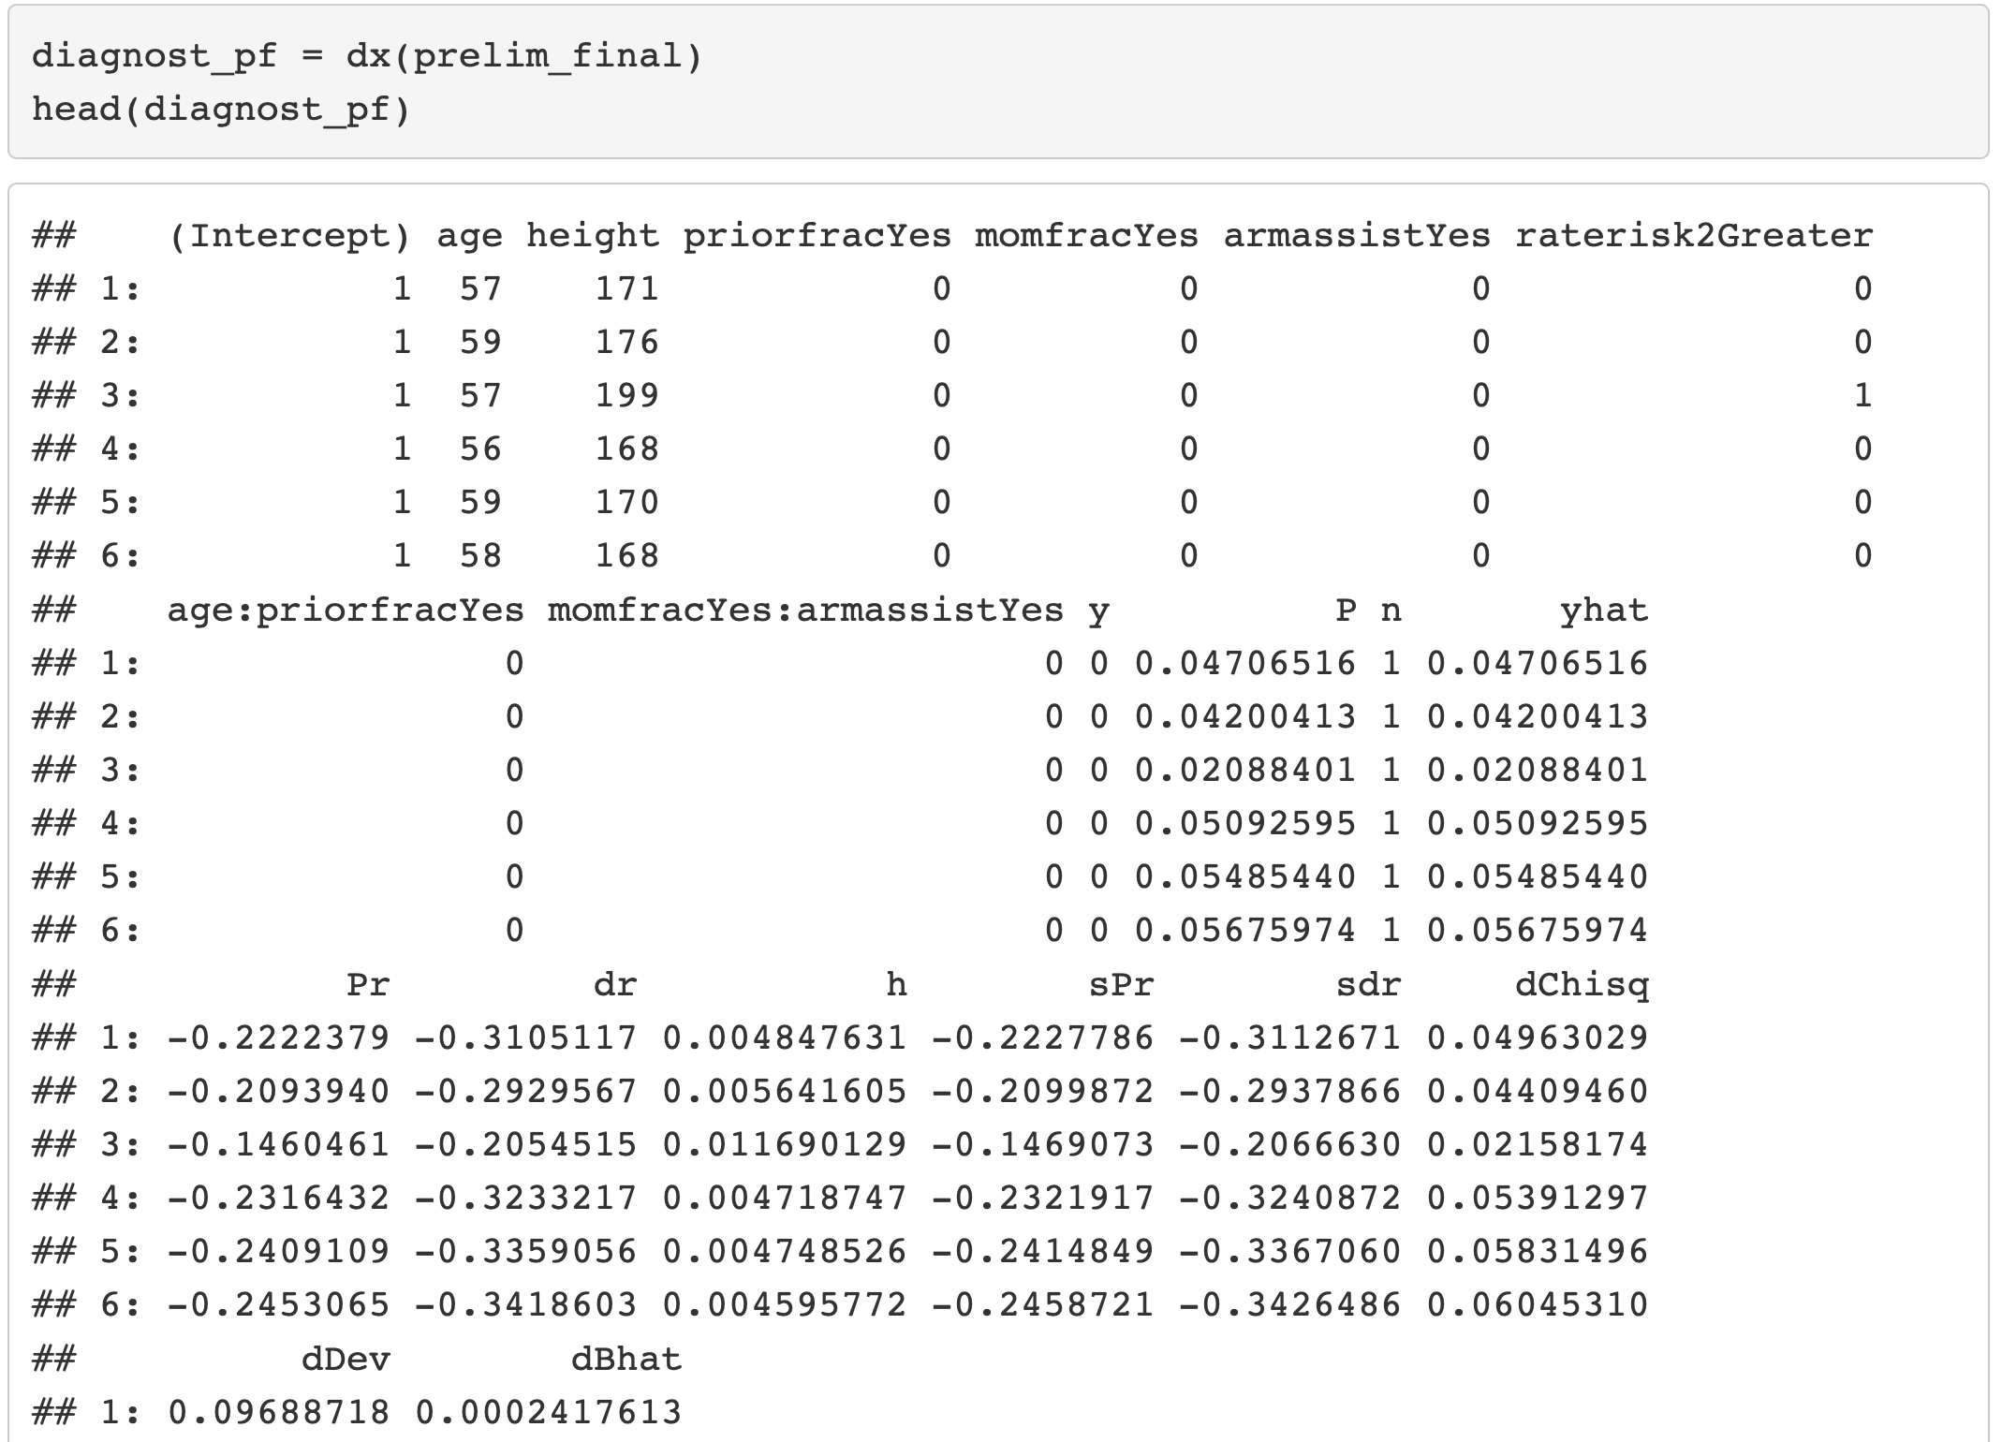
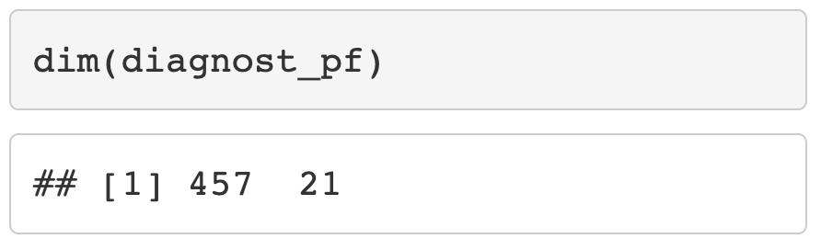
How do we get these values in R?

Slide 34
Poll Everywhere Question 2

Slide 35
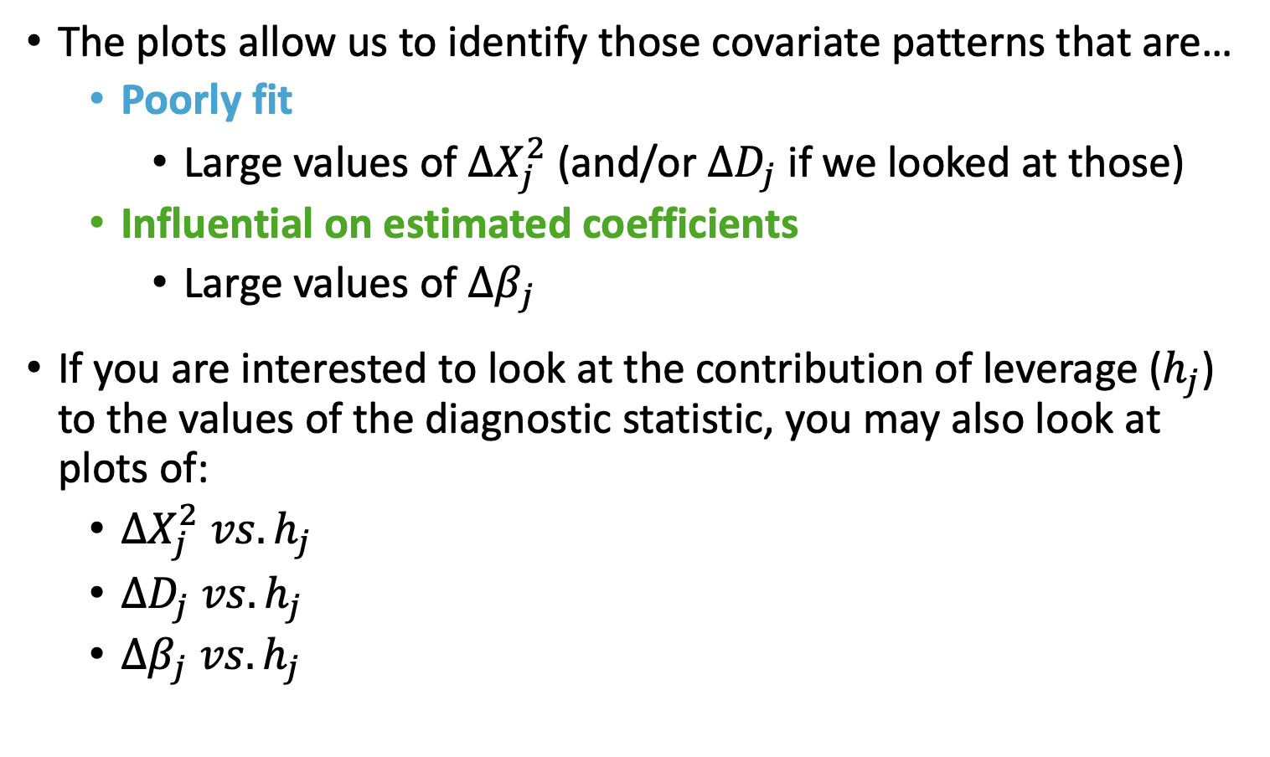
Visual Assessment for Diagnostics of Logistic Regression (II)
The plots allow us to identify those covariate patterns that are…
Poorly fit
Large values of $∆X_{j}^{2}$ (and/or $∆D_{j}$ if we looked at those)
Influential on estimated coefficients
Large values of $∆β_{j}$
If you are interested to look at the contribution of leverage ($h_{j}$) to the values of the diagnostic statistic, you may also look at plots of:
$∆X_{j}^{2} vs. h_{j}$
$∆D_{j} vs. h_{j}$
$∆β_{j} vs. h_{j}$

Slide 36
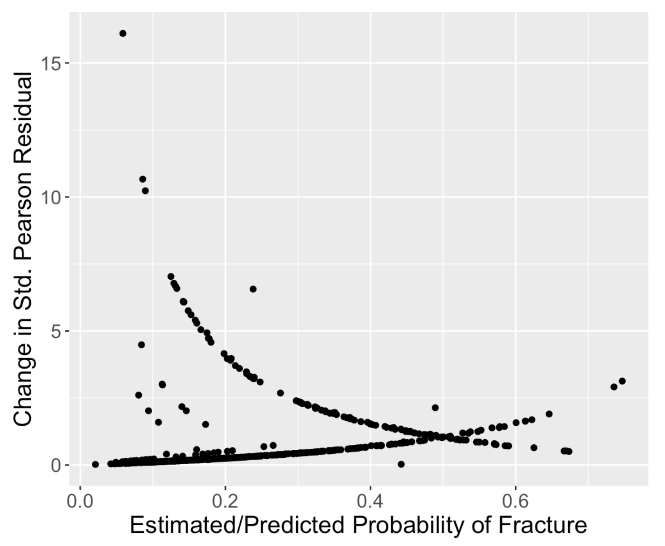
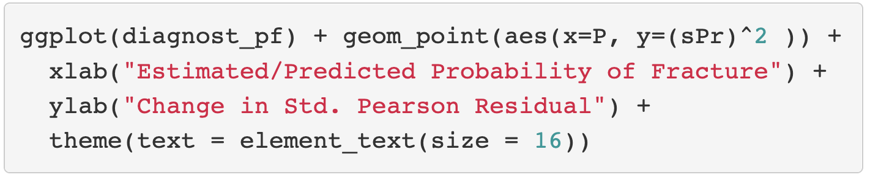
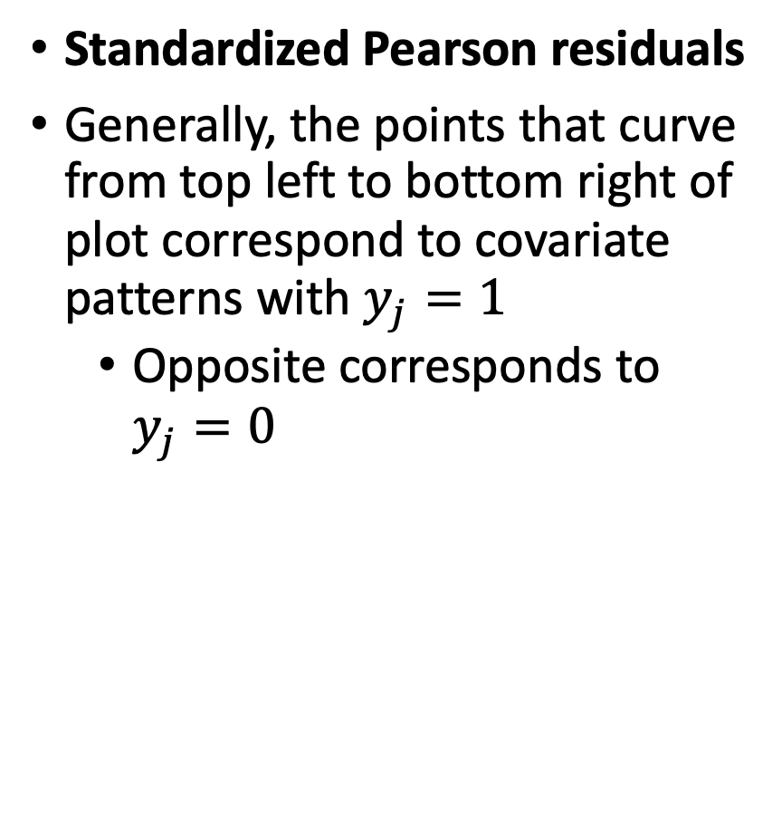
GLOW Study: Plot of $∆X_{j}^{2} vs. {\hat{π}}_{j}$ (I)
Standardized Pearson residuals
Generally, the points that curve from top left to bottom right of plot correspond to covariate patterns with $y_{j}=1$
Opposite corresponds to $y_{j}=0$

Slide 37
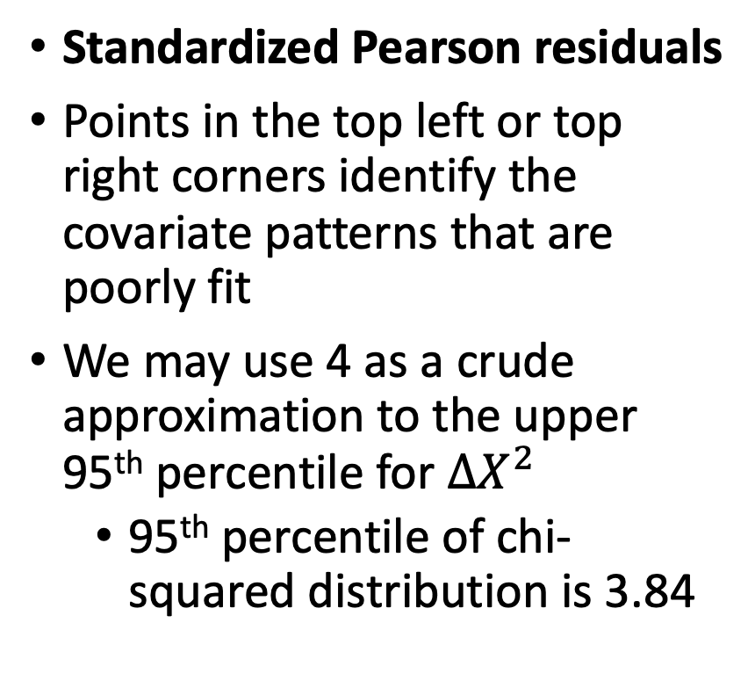
GLOW Study: Plot of $∆X_{j}^{2} vs. {\hat{π}}_{j}$ (II)
Standardized Pearson residuals
Points in the top left or top right corners identify the covariate patterns that are poorly fit
We may use 4 as a crude approximation to the upper 95th percentile for $∆X^{2}$
95th percentile of chi-squared distribution is 3.84

Slide 38
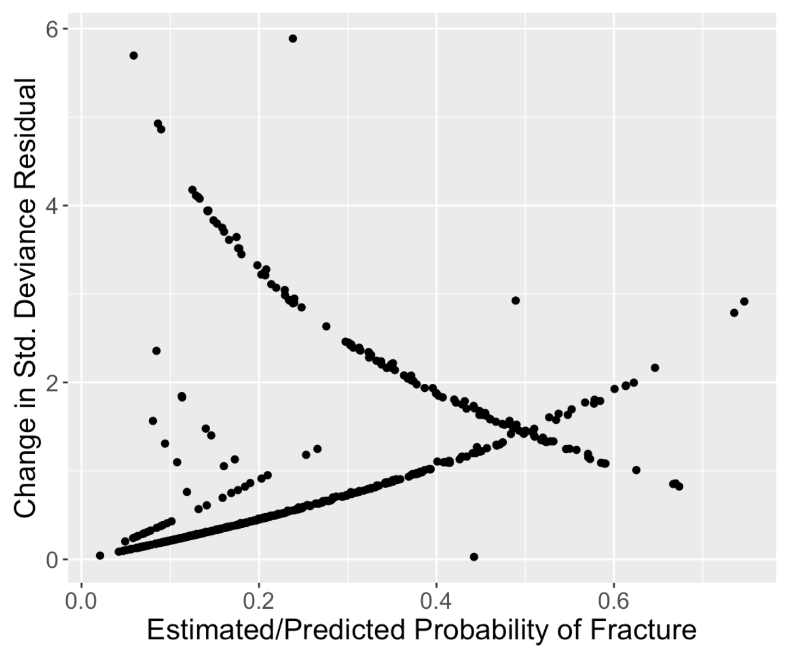
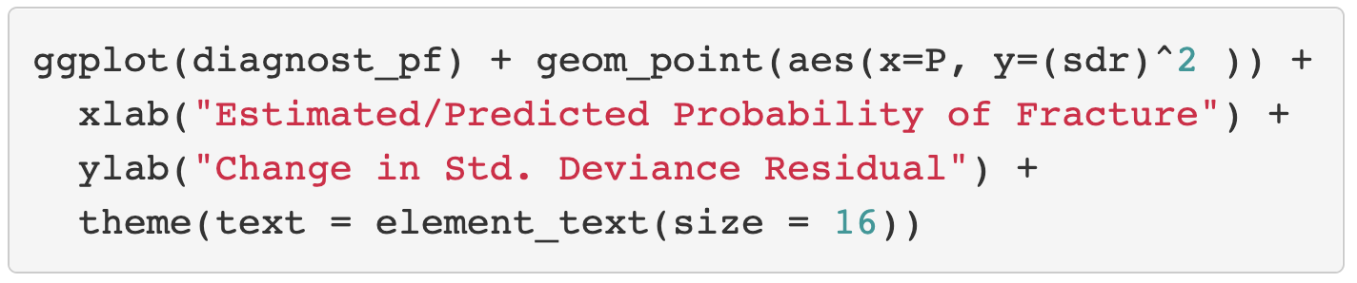
GLOW Study: Plot of $∆D_{j} vs. {\hat{π}}_{j}$
Standardized Deviance residuals
Same investigation as Pearson residuals
Points in the top left or top right corners identify the covariate patterns that are poorly fit
Use 4 as a crude approximation to the upper 95th percentile

Slide 39
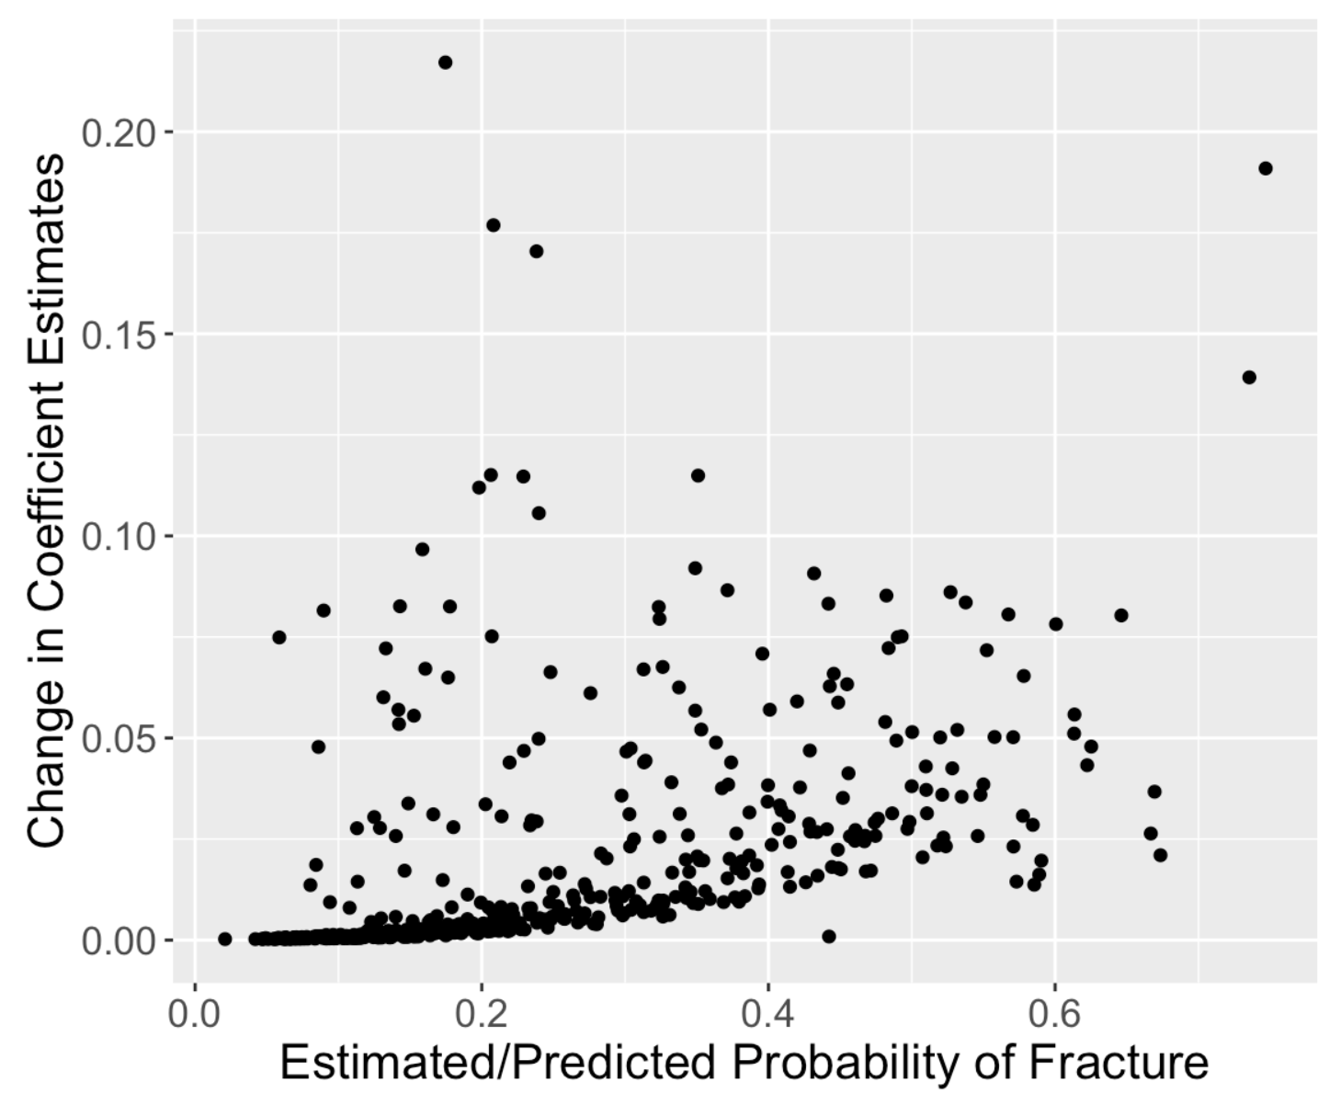
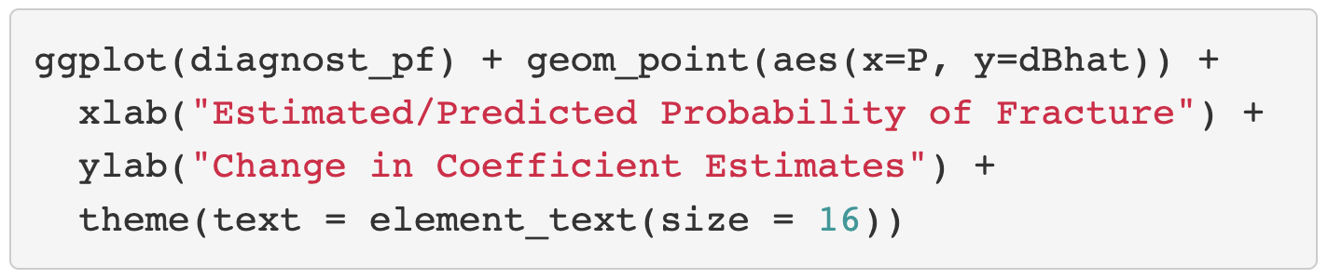
GLOW Study: Plot of $∆β_{j} vs. {\hat{π}}_{j}$
Change in coefficient estimates
About 5 points that are above 0.125 change in coefficients
Book recommends flagging certain covariate patterns if change in coefficient estimates are greater than 1

Slide 40
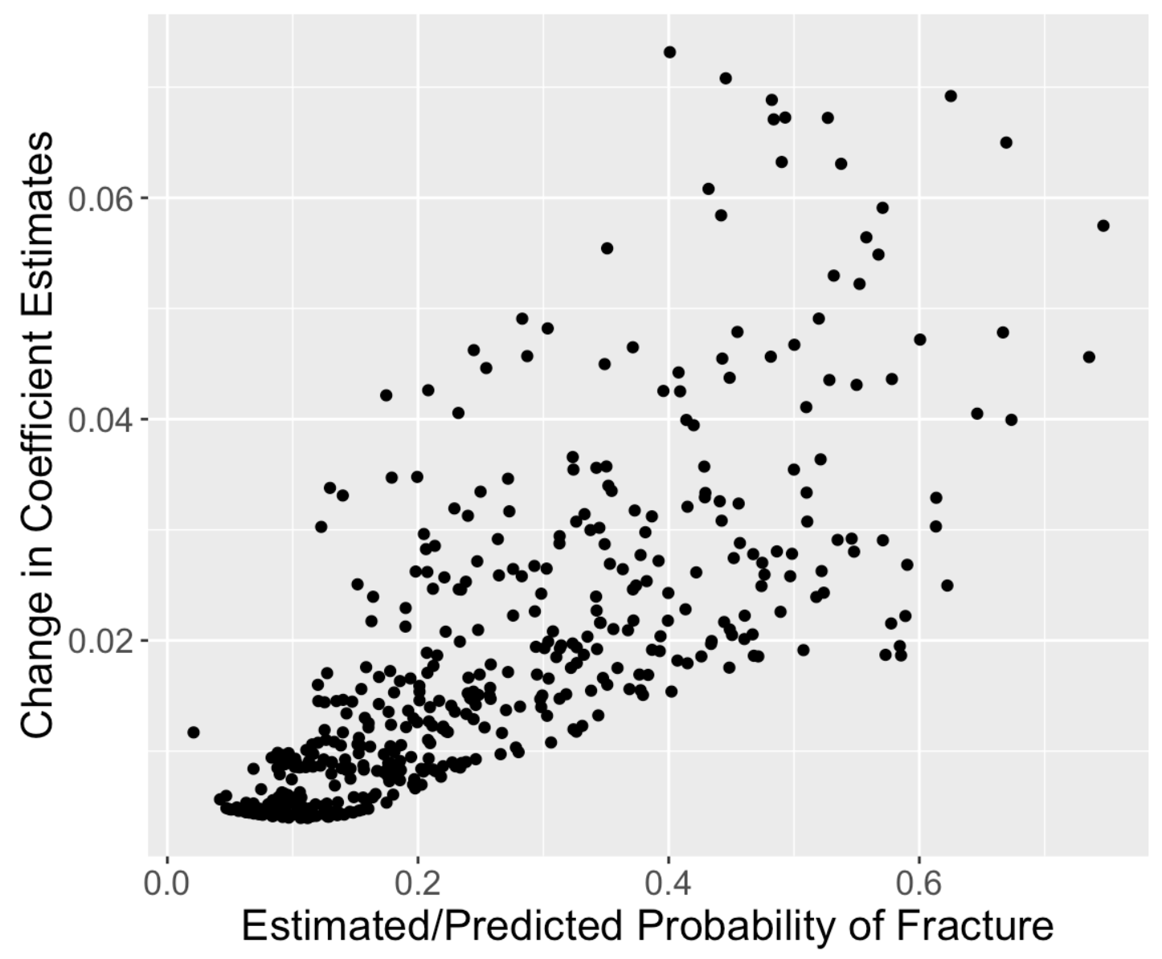
GLOW Study: Plot of $h_{j}$ vs. ${\hat{π}}_{j}$

Slide 41
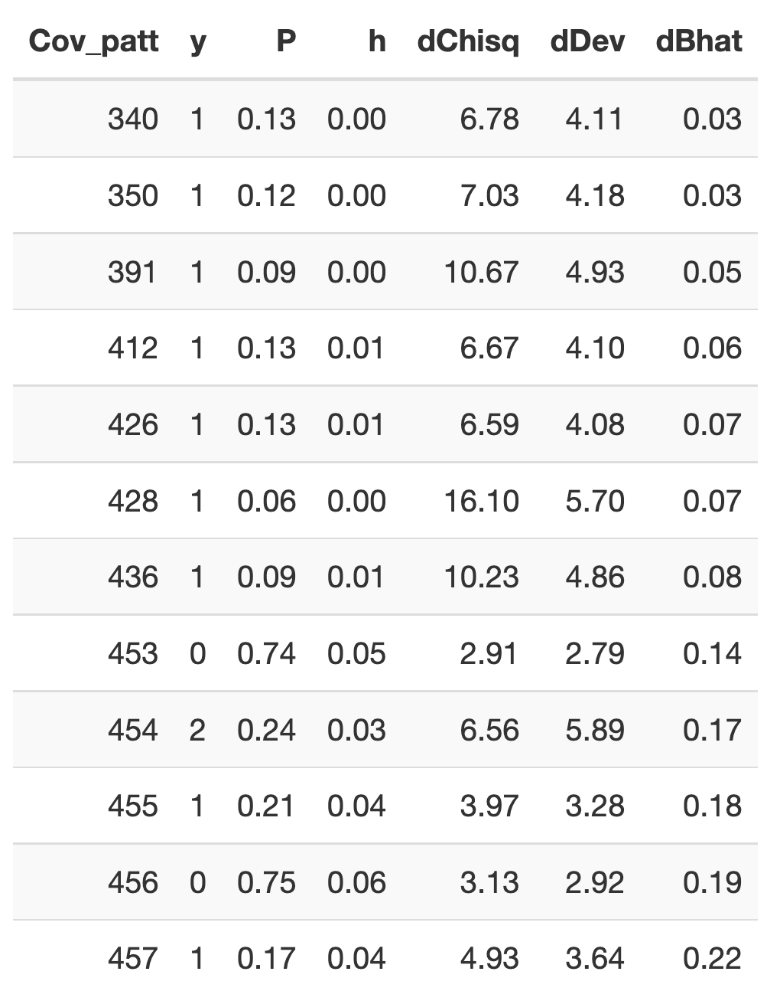
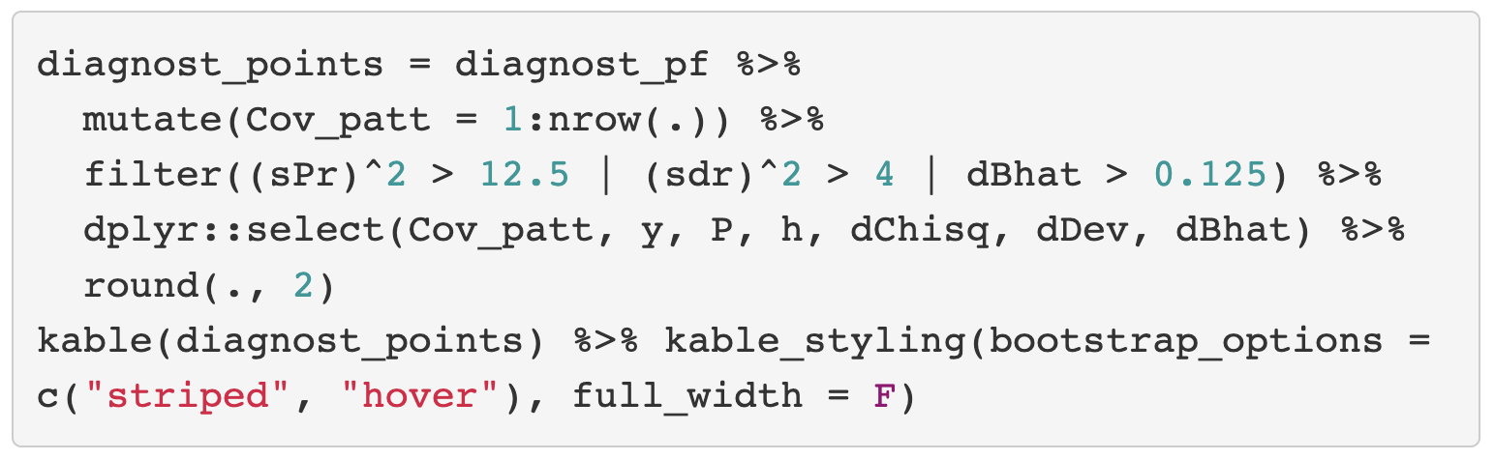
Find Out the “Influential” Observation From the Data Set
We visually identified covariate patterns that may be poorly fit or influential
How do we know which covariate patterns were the ones in the plot?

Slide 42
After identifying points to take out
Take them out and rerun your logistic regression model!
If we have time, we can switch over to R right now, and try this out
(Did not have time to prepare a well organized slide on this)

Slide 43
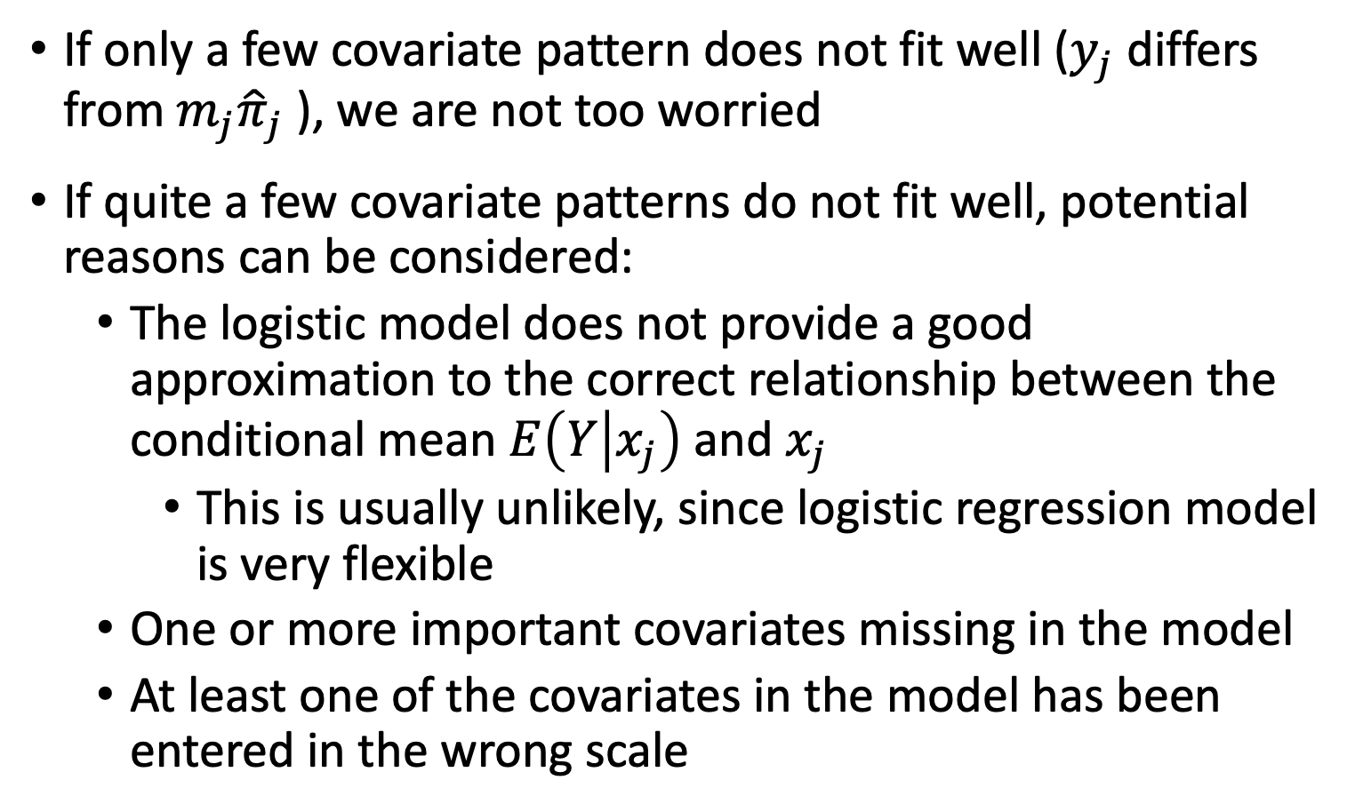
Three Potentials when Model Fits Poorly
If only a few covariate pattern does not fit well ($y_{j}$ differs from $m_{j}{\hat{π}}_{j}$ ), we are not too worried
If quite a few covariate patterns do not fit well, potential reasons can be considered:
The logistic model does not provide a good approximation to the correct relationship between the conditional mean $E\left(Y | x_{j}\right)$ and $x_{j}$
This is usually unlikely, since logistic regression model is very flexible
One or more important covariates missing in the model
At least one of the covariates in the model has been entered in the wrong scale

Slide 44

Wrap-up
4-minute exit ticket
Next class
Poisson Regression
https://forms.office.com/r/SnDwJxNFZa

